Slide 1
The Recording Process

Slide 2
The Account
An account is an individual accounting record of increases and decreases in a specific asset, liability, or owner’s equity item.
For example, a bookstore buys books on credit for tk 1000.
for this transaction, Inventory increases (Asset)
Accounts Payable increases (Liability)
Here, inventory is an account and Accounts Payable is another account.
Each transaction must have at least 2 accounts (sometimes there can be 3 or 4 accounts too)

Slide 3
Debit and Credit
Debit and credit are used in the recording process to determine the effects of business transactions on the financial positions of the company.
Items | Debit | Credit
Assets | increase | decrease
Expense | increase | decrease
Liability | decrease | increase
Owner’s equity | decrease | increase
Income/Revenue | decrease | Increase
 | Always recorded on the left side | Always recorded on the right side

Slide 4
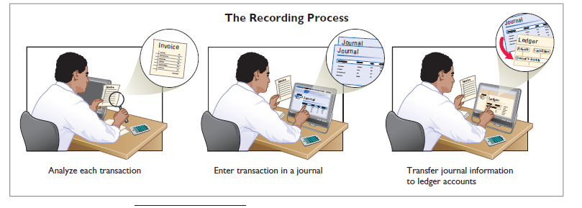
The Journal Entries
An initial recording process or recording book.
Shows the effects arising from a business transaction.
It is not an official record or formal working-book.
The book of original entry.

Slide 5
The Journal
The journal is the first record of all business transactions.
For each transaction, co. shows its debit side and credit side in the journal.
Journal maintains the chronological order of all transactions.
Date | entries | RefNo | Debit (amount) | Credit (amount)

Slide 6
The Journal Entries
Simple Entries
Some entries involve only two accounts, one debit and one credit. These are simple entries.
To illustrate, assume that on July 1, Butler Company purchases a delivery truck costing $14,000. Butler Co pays the full price in Cash.
Date | Accounts | Ref | Debit (dr) | Credit (cr)
July 1, 2020 | Equipment Dr Cash Cr |  | $14000 | $14000

Slide 7
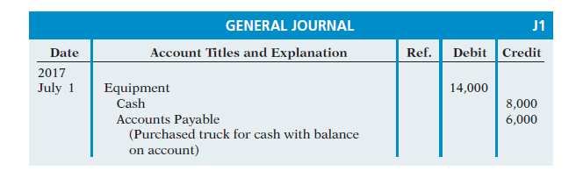
The Journal Entries
Compound Entries
Some transactions, however, require more than two accounts in journalizing. An entry that requires three or more accounts is a compound entry.
To illustrate, assume that on July 1, Butler Company purchases a delivery truck costing $14,000. It pays $8,000 cash now and agrees to pay the remaining $6,000 on account.

Slide 8
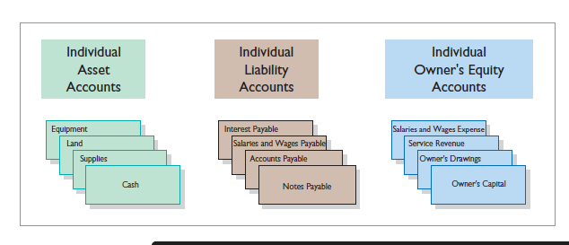
The Ledger
The entire group of accounts maintained by a company is the ledger.
A general ledger contains all the asset, liability, and owner’s equity accounts.

Slide 9
Ledger
Transferring accounts from journal to Ledger is called “posting”.
Ledger is actually the first formal record of all transactions.
Date | Explanation | Ref No | Debit | Credit | Balance

Slide 10
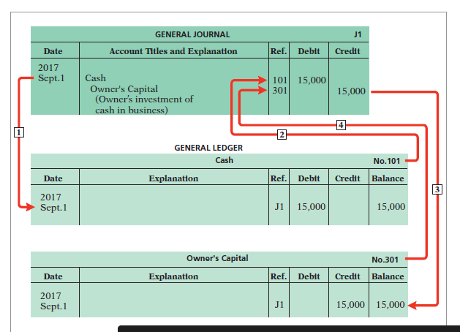
The ledger posting

Slide 11
Trial Balance
A trial balance is a list of accounts and their balances at a given time.
The trial balance proves the mathematical equality of debits and credits after posting.
Trial balance is useful in the preparation of financial statements.
Limitation
The trial balance does not prove that the company has recorded all transactions or that the ledger is correct.
A transaction is not journalized.
A correct journal entry is not posted.
A journal entry is posted twice.
Incorrect accounts are used in journalizing or posting.
Offsetting errors are made in recording the amount of a transaction.

Slide 12
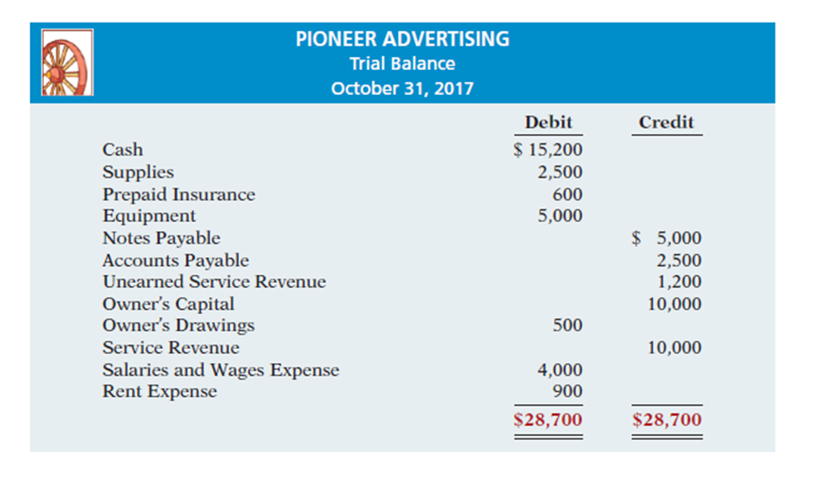
Example:

Slide 13
Some important points to remember
Trial balance is prepared by taking the end balance from ledger accounts.
In the ledger accounts
All asset accounts always have Debit Balance
All liability accounts always have Credit Balance
All equity account always have Credit Balance; except for Drawings which has Debit Balance.
All income accounts have Credit Balance
All expenses accounts have Debit Balance.

